Slide 1
Pairwise alignments in the 1950s
β-corticotropin (sheep)
Corticotropin A (pig)
ala gly glu asp asp glu
asp gly ala glu asp glu
Oxytocin
Vasopressin
CYIQNCPLG
CYFQNCPRG

Slide 2
Pairwise sequence alignment is the most
fundamental operation of bioinformatics
• It is used to decide if two proteins (or genes)
are related structurally or functionally
• It is used to identify domains or motifs that
are shared between proteins
It is the basis of BLAST searching
• It is used in the analysis of genomes

Slide 3
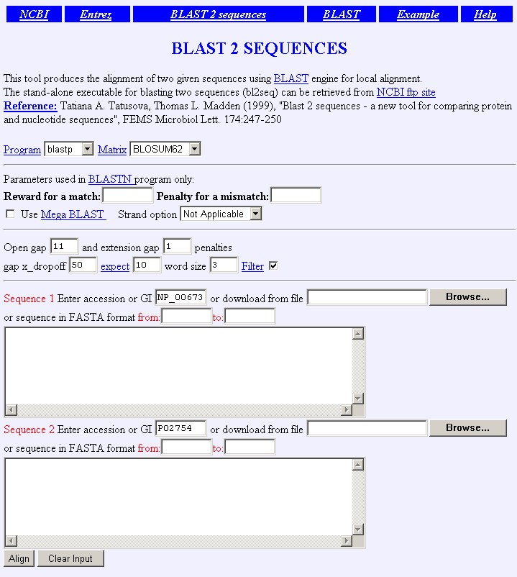

Slide 4
Pairwise alignment: protein sequences
can be more informative than DNA
• protein is more informative (20 vs 4 characters);
many amino acids share related biophysical properties
• codons are degenerate: changes in the third position
often do not alter the amino acid that is specified
• protein sequences offer a longer “look-back” time
DNA sequences can be translated into protein,
and then used in pairwise alignments

Slide 5
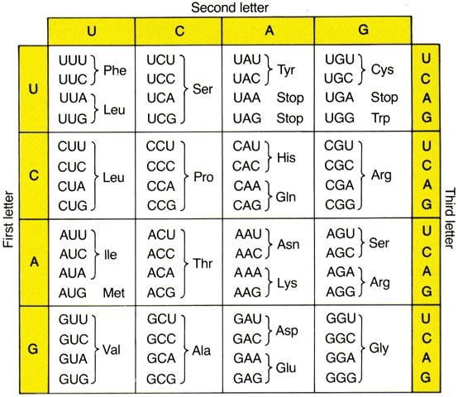
Page 54

Slide 6
Pairwise alignment: protein sequences
can be more informative than DNA
• DNA can be translated into six potential proteins
5’ CAT CAA
5’ ATC AAC
5’ TCA ACT
5’ CATCAACTACAACTCCAAAGACACCCTTACACATCAACAAACCTACCCAC 3’
3’ GTAGTTGATGTTGAGGTTTCTGTGGGAATGTGTAGTTGTTTGGATGGGTG 5’
5’ GTG GGT
5’ TGG GTA
5’ GGG TAG

Slide 7
Pairwise alignment: protein sequences
can be more informative than DNA
Many times, DNA alignments are appropriate
--to confirm the identity of a cDNA
--to study noncoding regions of DNA
--to study DNA polymorphisms
--example: Neanderthal vs modern human DNA
Query: 181 catcaactacaactccaaagacacccttacacccactaggatatcaacaaacctacccac 240
|||||||| |||| |||||| ||||| | |||||||||||||||||||||||||||||||
Sbjct: 189 catcaactgcaaccccaaagccacccct-cacccactaggatatcaacaaacctacccac 247

Slide 8
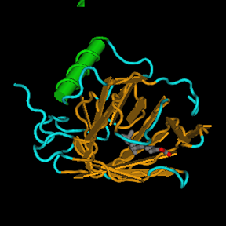
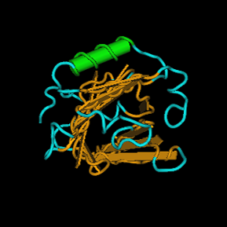
retinol-binding protein 4
(NP_006735)
β-lactoglobulin
(P02754)

Slide 9
Definitions (Tanımlar)
Pairwise alignment (Karşılaştırmalı eşleştirme)
The process of lining up two or more sequences
to achieve maximal levels of identity
(İki veya daha fazla dizinin en fazla eşleşeceği biçimde çakıştırılması)
(and conservation, in the case of amino acid sequences)
for the purpose of assessing the degree of similarity
and the possibility of homology.
(Benzerlik derecesini ve homoloji seviyesini belirlemeyi amaçlamak)

Slide 10
Definitions (Tanımlar)
Homology (Homoloji)
Similarity attributed to descent from a common ancestor.
(Ortak bir atadan ayrılmanın sonucu olarak gelen benzerlik)

Slide 11
Definitions
Homology (Homoloji)
Similarity attributed to descent from a common ancestor.
Identity (Aynılık)
The extent to which two (nucleotide or amino acid) sequences are invariant.
iki dizinin birbirlerinden farklı olmadıkları yerler (Nükleotid veya amino asit)
RBP: 26 RVKENFDKARFSGTWYAMAKKDPEGLFLQDNIVA 59
+ K++ + ++ GTW++MA + L + A
glycodelin: 23 QTKQDLELPKLAGTWHSMAMA-TNNISLMATLKA 55

Slide 12
Definitions: two types of homology
Orthologs
Homologous sequences in different species
that arose from a common ancestral gene
during speciation; may or may not be responsible
for a similar function.
Paralogs
Homologous sequences within a single species
that arose by gene duplication.

Slide 13
common carp
Orthologs:
members of a
gene (protein)
family in various
organisms.
This tree shows
RBP orthologs.
zebrafish
rainbow trout
teleost
African
clawed
frog
chicken
human
mouse
horse
rat
pig
cow
rabbit
10 changes

Slide 14
apolipoprotein D
Paralogs:
members of a
gene (protein)
family within a
species
retinol-binding
protein 4
Complement
component 8
Alpha-1
Microglobulin
/bikunin
prostaglandin
D2 synthase
progestagen-
associated
endometrial
protein
neutrophil
gelatinase-
associated
lipocalin
Odorant-binding
protein 2A
Lipocalin 1
10 changes

Slide 15
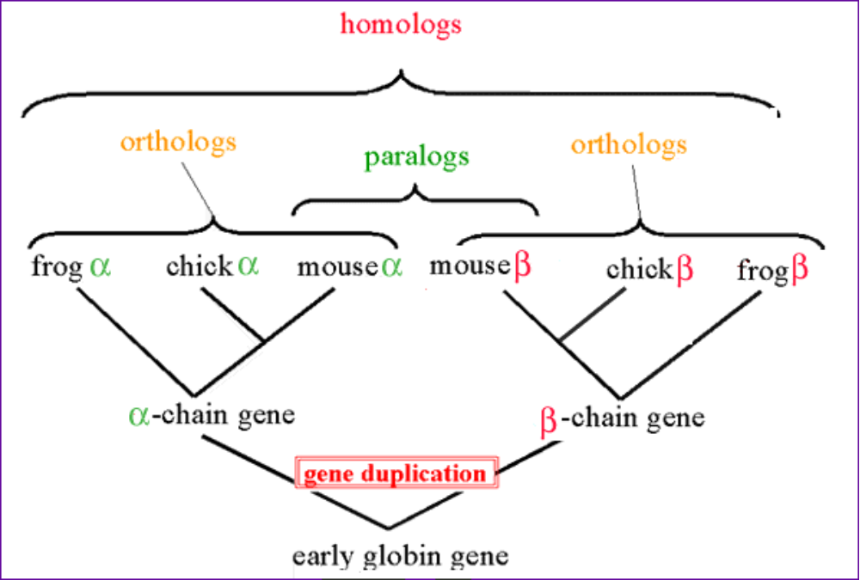

Slide 16
Pairwise alignment of retinol-binding protein 4
and β-lactoglobulin
1 MKWVWALLLLAAWAAAERDCRVSSFRVKENFDKARFSGTWYAMAKKDPEG 50 RBP
. ||| | . |. . . | : .||||.:| :
1 ...MKCLLLALALTCGAQALIVT..QTMKGLDIQKVAGTWYSLAMAASD. 44 lactoglobulin
51 LFLQDNIVAEFSVDETGQMSATAKGRVR.LLNNWD..VCADMVGTFTDTE 97 RBP
: | | | | :: | .| . || |: || |.
45 ISLLDAQSAPLRV.YVEELKPTPEGDLEILLQKWENGECAQKKIIAEKTK 93 lactoglobulin
98 DPAKFKMKYWGVASFLQKGNDDHWIVDTDYDTYAV...........QYSC 136 RBP
|| ||. | :.|||| | . .|
94 IPAVFKIDALNENKVL........VLDTDYKKYLLFCMENSAEPEQSLAC 135 lactoglobulin
137 RLLNLDGTCADSYSFVFSRDPNGLPPEAQKIVRQRQ.EELCLARQYRLIV 185 RBP
. | | | : || . | || |
136 QCLVRTPEVDDEALEKFDKALKALPMHIRLSFNPTQLEEQCHI....... 178 lactoglobulin

Slide 17
Definitions
Similarity
The extent to which nucleotide or protein sequences are related. It is based upon identity plus conservation.
Identity
The extent to which two sequences are invariant.
Conservation
Changes at a specific position of an amino acid or (less commonly, DNA) sequence that preserve the physico-chemical properties of the original residue.

Slide 18
Pairwise alignment of retinol-binding protein
and β-lactoglobulin
1 MKWVWALLLLAAWAAAERDCRVSSFRVKENFDKARFSGTWYAMAKKDPEG 50 RBP
. ||| | . |. . . | : .||||.:| :
1 ...MKCLLLALALTCGAQALIVT..QTMKGLDIQKVAGTWYSLAMAASD. 44 lactoglobulin
51 LFLQDNIVAEFSVDETGQMSATAKGRVR.LLNNWD..VCADMVGTFTDTE 97 RBP
: | | | | :: | .| . || |: || |.
45 ISLLDAQSAPLRV.YVEELKPTPEGDLEILLQKWENGECAQKKIIAEKTK 93 lactoglobulin
98 DPAKFKMKYWGVASFLQKGNDDHWIVDTDYDTYAV...........QYSC 136 RBP
|| ||. | :.|||| | . .|
94 IPAVFKIDALNENKVL........VLDTDYKKYLLFCMENSAEPEQSLAC 135 lactoglobulin
137 RLLNLDGTCADSYSFVFSRDPNGLPPEAQKIVRQRQ.EELCLARQYRLIV 185 RBP
. | | | : || . | || |
136 QCLVRTPEVDDEALEKFDKALKALPMHIRLSFNPTQLEEQCHI....... 178 lactoglobulin
Identity
(bar)

Slide 19
Pairwise alignment of retinol-binding protein
and β-lactoglobulin
1 MKWVWALLLLAAWAAAERDCRVSSFRVKENFDKARFSGTWYAMAKKDPEG 50 RBP
. ||| | . |. . . | : .||||.:| :
1 ...MKCLLLALALTCGAQALIVT..QTMKGLDIQKVAGTWYSLAMAASD. 44 lactoglobulin
51 LFLQDNIVAEFSVDETGQMSATAKGRVR.LLNNWD..VCADMVGTFTDTE 97 RBP
: | | | | :: | .| . || |: || |.
45 ISLLDAQSAPLRV.YVEELKPTPEGDLEILLQKWENGECAQKKIIAEKTK 93 lactoglobulin
98 DPAKFKMKYWGVASFLQKGNDDHWIVDTDYDTYAV...........QYSC 136 RBP
|| ||. | :.|||| | . .|
94 IPAVFKIDALNENKVL........VLDTDYKKYLLFCMENSAEPEQSLAC 135 lactoglobulin
137 RLLNLDGTCADSYSFVFSRDPNGLPPEAQKIVRQRQ.EELCLARQYRLIV 185 RBP
. | | | : || . | || |
136 QCLVRTPEVDDEALEKFDKALKALPMHIRLSFNPTQLEEQCHI....... 178 lactoglobulin
Somewhat
similar
(one dot)
Very
similar
(two dots)

Slide 20
Definitions
Pairwise alignment
The process of lining up two or more sequences
to achieve maximal levels of identity
(and conservation, in the case of amino acid sequences)
for the purpose of assessing the degree of similarity
and the possibility of homology.

Slide 21
Pairwise alignment of retinol-binding protein
and β-lactoglobulin
1 MKWVWALLLLAAWAAAERDCRVSSFRVKENFDKARFSGTWYAMAKKDPEG 50 RBP
. ||| | . |. . . | : .||||.:| :
1 ...MKCLLLALALTCGAQALIVT..QTMKGLDIQKVAGTWYSLAMAASD. 44 lactoglobulin
51 LFLQDNIVAEFSVDETGQMSATAKGRVR.LLNNWD..VCADMVGTFTDTE 97 RBP
: | | | | :: | .| . || |: || |.
45 ISLLDAQSAPLRV.YVEELKPTPEGDLEILLQKWENGECAQKKIIAEKTK 93 lactoglobulin
98 DPAKFKMKYWGVASFLQKGNDDHWIVDTDYDTYAV...........QYSC 136 RBP
|| ||. | :.|||| | . .|
94 IPAVFKIDALNENKVL........VLDTDYKKYLLFCMENSAEPEQSLAC 135 lactoglobulin
137 RLLNLDGTCADSYSFVFSRDPNGLPPEAQKIVRQRQ.EELCLARQYRLIV 185 RBP
. | | | : || . | || |
136 QCLVRTPEVDDEALEKFDKALKALPMHIRLSFNPTQLEEQCHI....... 178 lactoglobulin
Internal
gap
Terminal
gap

Slide 22
Gaps
• Positions at which a letter is paired with a null
are called gaps.
• Gap scores are typically negative.
• Since a single mutational event may cause the insertion
or deletion of more than one residue, the presence of
a gap is ascribed more significance than the length
of the gap.
• In BLAST, it is rarely necessary to change gap values
from the default.

Slide 23
Pairwise alignment of retinol-binding protein
and β-lactoglobulin
1 MKWVWALLLLAAWAAAERDCRVSSFRVKENFDKARFSGTWYAMAKKDPEG 50 RBP
. ||| | . |. . . | : .||||.:| :
1 ...MKCLLLALALTCGAQALIVT..QTMKGLDIQKVAGTWYSLAMAASD. 44 lactoglobulin
51 LFLQDNIVAEFSVDETGQMSATAKGRVR.LLNNWD..VCADMVGTFTDTE 97 RBP
: | | | | :: | .| . || |: || |.
45 ISLLDAQSAPLRV.YVEELKPTPEGDLEILLQKWENGECAQKKIIAEKTK 93 lactoglobulin
98 DPAKFKMKYWGVASFLQKGNDDHWIVDTDYDTYAV...........QYSC 136 RBP
|| ||. | :.|||| | . .|
94 IPAVFKIDALNENKVL........VLDTDYKKYLLFCMENSAEPEQSLAC 135 lactoglobulin
137 RLLNLDGTCADSYSFVFSRDPNGLPPEAQKIVRQRQ.EELCLARQYRLIV 185 RBP
. | | | : || . | || |
136 QCLVRTPEVDDEALEKFDKALKALPMHIRLSFNPTQLEEQCHI....... 178 lactoglobulin

Slide 24
Pairwise alignment of retinol-binding protein
from human (top) and rainbow trout (O. mykiss)
1 .MKWVWALLLLA.AWAAAERDCRVSSFRVKENFDKARFSGTWYAMAKKDP 48
:: || || || .||.||. .| :|||:.|:.| |||.|||||
1 MLRICVALCALATCWA...QDCQVSNIQVMQNFDRSRYTGRWYAVAKKDP 47
. . . . .
49 EGLFLQDNIVAEFSVDETGQMSATAKGRVRLLNNWDVCADMVGTFTDTED 98
|||| ||:||:|||||.|.|.||| ||| :||||:.||.| ||| || |
48 VGLFLLDNVVAQFSVDESGKMTATAHGRVIILNNWEMCANMFGTFEDTPD 97
. . . . .
99 PAKFKMKYWGVASFLQKGNDDHWIVDTDYDTYAVQYSCRLLNLDGTCADS 148
||||||:||| ||:|| ||||||::||||| ||: |||| ..||||| |
98 PAKFKMRYWGAASYLQTGNDDHWVIDTDYDNYAIHYSCREVDLDGTCLDG 147
. . . . .
149 YSFVFSRDPNGLPPEAQKIVRQRQEELCLARQYRLIVHNGYCDGRSERNLL 199
|||:||| | || || |||| :..|:| .|| : | |:|:
148 YSFIFSRHPTGLRPEDQKIVTDKKKEICFLGKYRRVGHTGFCESS...... 192

Slide 25
Pairwise sequence alignment allows us
to look back billions of years ago (BYA)
Origin of
life
Earliest
fossils
Origin of
eukaryotes
Eukaryote/
archaea
Fungi/animal
Plant/animal
insects
4
3
2
1
0

Slide 26
Multiple sequence alignment of
glyceraldehyde 3-phosphate dehydrogenases
fly GAKKVIISAP SAD.APM..F VCGVNLDAYK PDMKVVSNAS CTTNCLAPLA
human GAKRVIISAP SAD.APM..F VMGVNHEKYD NSLKIISNAS CTTNCLAPLA
plant GAKKVIISAP SAD.APM..F VVGVNEHTYQ PNMDIVSNAS CTTNCLAPLA
bacterium GAKKVVMTGP SKDNTPM..F VKGANFDKY. AGQDIVSNAS CTTNCLAPLA
yeast GAKKVVITAP SS.TAPM..F VMGVNEEKYT SDLKIVSNAS CTTNCLAPLA
archaeon GADKVLISAP PKGDEPVKQL VYGVNHDEYD GE.DVVSNAS CTTNSITPVA
fly KVINDNFEIV EGLMTTVHAT TATQKTVDGP SGKLWRDGRG AAQNIIPAST
human KVIHDNFGIV EGLMTTVHAI TATQKTVDGP SGKLWRDGRG ALQNIIPAST
plant KVVHEEFGIL EGLMTTVHAT TATQKTVDGP SMKDWRGGRG ASQNIIPSST
bacterium KVINDNFGII EGLMTTVHAT TATQKTVDGP SHKDWRGGRG ASQNIIPSST
yeast KVINDAFGIE EGLMTTVHSL TATQKTVDGP SHKDWRGGRT ASGNIIPSST
archaeon KVLDEEFGIN AGQLTTVHAY TGSQNLMDGP NGKP.RRRRA AAENIIPTST
fly GAAKAVGKVI PALNGKLTGM AFRVPTPNVS VVDLTVRLGK GASYDEIKAK
human GAAKAVGKVI PELNGKLTGM AFRVPTANVS VVDLTCRLEK PAKYDDIKKV
plant GAAKAVGKVL PELNGKLTGM AFRVPTSNVS VVDLTCRLEK GASYEDVKAA
bacterium GAAKAVGKVL PELNGKLTGM AFRVPTPNVS VVDLTVRLEK AATYEQIKAA
yeast GAAKAVGKVL PELQGKLTGM AFRVPTVDVS VVDLTVKLNK ETTYDEIKKV
archaeon GAAQAATEVL PELEGKLDGM AIRVPVPNGS ITEFVVDLDD DVTESDVNAA

Slide 27
Multiple sequence alignment of
human lipocalin paralogs
~~~~~EIQDVSGTWYAMTVDREFPEMNLESVTPMTLTTL.GGNLEAKVTM lipocalin 1
LSFTLEEEDITGTWYAMVVDKDFPEDRRRKVSPVKVTALGGGNLEATFTF odorant-binding protein 2a
TKQDLELPKLAGTWHSMAMATNNISLMATLKAPLRVHITSEDNLEIVLHR progestagen-assoc. endo.
VQENFDVNKYLGRWYEIEKIPTTFENGRCIQANYSLMENGNQELRADGTV apolipoprotein D
VKENFDKARFSGTWYAMAKDPEGLFLQDNIVAEFSVDETGNWDVCADGTF retinol-binding protein
LQQNFQDNQFQGKWYVVGLAGNAI.LREDKDPQKMYATIDKSYNVTSVLF neutrophil gelatinase-ass.
VQPNFQQDKFLGRWFSAGLASNSSWLREKKAALSMCKSVDGGLNLTSTFL prostaglandin D2 synthase
VQENFNISRIYGKWYNLAIGSTCPWMDRMTVSTLVLGEGEAEISMTSTRW alpha-1-microglobulin
PKANFDAQQFAGTWLLVAVGSACRFLQRAEATTLHVAPQGSTFRKLD... complement component 8

Slide 28
General approach to pairwise alignment
Choose two sequences
Select an algorithm that generates a score
Allow gaps (insertions, deletions)
Score reflects degree of similarity
Alignments can be global or local
Estimate probability that the alignment
occurred by chance

Slide 29
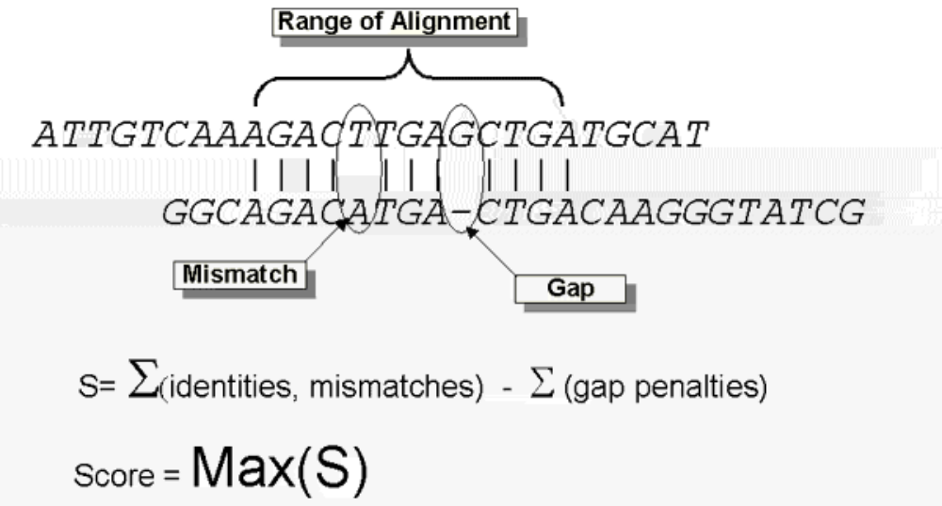
Calculation of an alignment score
Source: http://www.ncbi.nlm.nih.gov/Education/BLASTinfo/Alignment_Scores2.html

Slide 30

Dayhoff’s numbers of “accepted point mutations”:
what amino acid substitutions occur in proteins?
Page 52

Slide 31
Multiple sequence alignment of
glyceraldehyde 3-phosphate dehydrogenases
fly GAKKVIISAP SAD.APM..F VCGVNLDAYK PDMKVVSNAS CTTNCLAPLA
human GAKRVIISAP SAD.APM..F VMGVNHEKYD NSLKIISNAS CTTNCLAPLA
plant GAKKVIISAP SAD.APM..F VVGVNEHTYQ PNMDIVSNAS CTTNCLAPLA
bacterium GAKKVVMTGP SKDNTPM..F VKGANFDKY. AGQDIVSNAS CTTNCLAPLA
yeast GAKKVVITAP SS.TAPM..F VMGVNEEKYT SDLKIVSNAS CTTNCLAPLA
archaeon GADKVLISAP PKGDEPVKQL VYGVNHDEYD GE.DVVSNAS CTTNSITPVA
fly KVINDNFEIV EGLMTTVHAT TATQKTVDGP SGKLWRDGRG AAQNIIPAST
human KVIHDNFGIV EGLMTTVHAI TATQKTVDGP SGKLWRDGRG ALQNIIPAST
plant KVVHEEFGIL EGLMTTVHAT TATQKTVDGP SMKDWRGGRG ASQNIIPSST
bacterium KVINDNFGII EGLMTTVHAT TATQKTVDGP SHKDWRGGRG ASQNIIPSST
yeast KVINDAFGIE EGLMTTVHSL TATQKTVDGP SHKDWRGGRT ASGNIIPSST
archaeon KVLDEEFGIN AGQLTTVHAY TGSQNLMDGP NGKP.RRRRA AAENIIPTST
fly GAAKAVGKVI PALNGKLTGM AFRVPTPNVS VVDLTVRLGK GASYDEIKAK
human GAAKAVGKVI PELNGKLTGM AFRVPTANVS VVDLTCRLEK PAKYDDIKKV
plant GAAKAVGKVL PELNGKLTGM AFRVPTSNVS VVDLTCRLEK GASYEDVKAA
bacterium GAAKAVGKVL PELNGKLTGM AFRVPTPNVS VVDLTVRLEK AATYEQIKAA
yeast GAAKAVGKVL PELQGKLTGM AFRVPTVDVS VVDLTVKLNK ETTYDEIKKV
archaeon GAAQAATEVL PELEGKLDGM AIRVPVPNGS ITEFVVDLDD DVTESDVNAA

Slide 32
The relative mutability of amino acids
Asn 134 His 66
Ser 120 Arg 65
Asp 106 Lys 56
Glu 102 Pro 56
Ala 100 Gly 49
Thr 97 Tyr 41
Ile 96 Phe 41
Met 94 Leu 40
Gln 93 Cys 20
Val 74 Trp 18
Page 53

Slide 33
Normalized frequencies of amino acids
Gly 8.9% Arg 4.1%
Ala 8.7% Asn 4.0%
Leu 8.5% Phe 4.0%
Lys 8.1% Gln 3.8%
Ser 7.0% Ile 3.7%
Val 6.5% His 3.4%
Thr 5.8% Cys 3.3%
Pro 5.1% Tyr 3.0%
Glu 5.0% Met 1.5%
Asp 4.7% Trp 1.0%
blue=6 codons; red=1 codon
Page 53

Slide 34
Page 54

Slide 35
How FASTA works
[1] A “lookup table” is created. It consists of short
stretches of amino acids (e.g. k=3 for a protein search).
The length of a stretch is called a k-tuple. The FASTA
algorithm finds the ten highest scoring segments
that align to the query.
[2] These ten aligned regions are re-scored with a
PAM or BLOSUM matrix.
[3] High-scoring segments are joined.
[4] Needleman-Wunsch or Smith-Waterman is then performed.
Page 72

Slide 36
Pairwise alignment: BLAST 2 sequences
• Go to http://www.ncbi.nlm.nih.gov/BLAST
• Choose BLAST 2 sequences
• In the program,
[1] choose blastp or blastn
[2] paste in your accession numbers
(use FASTA format)
[3] select optional parameters
--BLOSUM and PAM matrices
--gap creation and extension penalties
--filtering
--word size
[4] click “align”
Page 72

Slide 37
Page 73

Slide 38
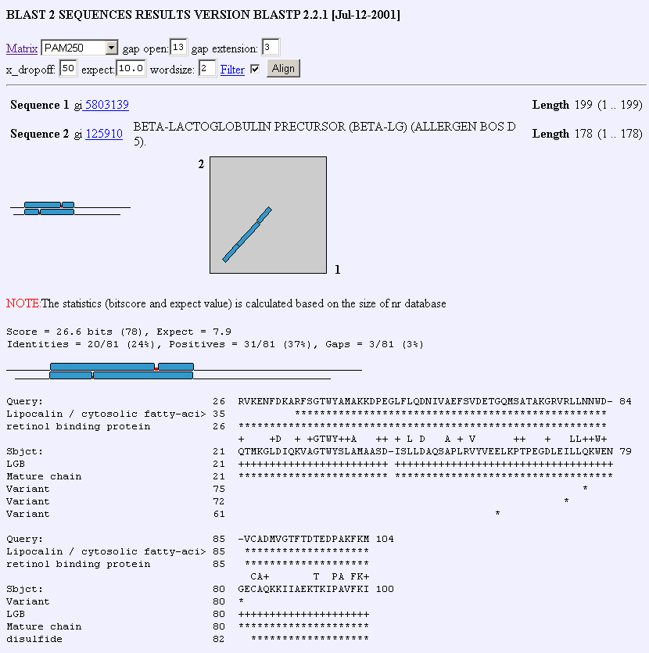
Page 74

Slide 39
Sequences reported
as related
True positives
False positives
Sequences reported
as unrelated
False negatives
True negatives
Page 76

Slide 40
homologous
sequences
non-homologous
sequences
Sequences reported
as related
True positives
False positives
Sequences reported
as unrelated
False negatives
True negatives
Page 76

Slide 41
homologous
sequences
non-homologous
sequences
Sequences reported
as related
True positives
False positives
Sequences reported
as unrelated
False negatives
True negatives
Sensitivity:
ability to find
true positives
Specificity:
ability to minimize
false positives

Slide 42
Randomization test: scramble a sequence
• First compare two proteins and obtain a score
RBP: 26 RVKENFDKARFSGTWYAMAKKDPEGLFLQDNIVAEFSVDETGQMSATAKGRVRLLNNWD- 84
+ K++ + + +GTW++MA + L + A V T + +L+ W+
glycodelin: 23 QTKQDLELPKLAGTWHSMAMA-TNNISLMATLKAPLRVHITSLLPTPEDNLEIVLHRWEN 81
• Next scramble the bottom sequence 100 times,
and obtain 100 “randomized” scores (+/- standard deviation)
• Composition and length are maintained
• If the comparison is “real” we expect the authentic score
to be several standard deviations above the mean of the
“randomized” scores
Page 76

Slide 43
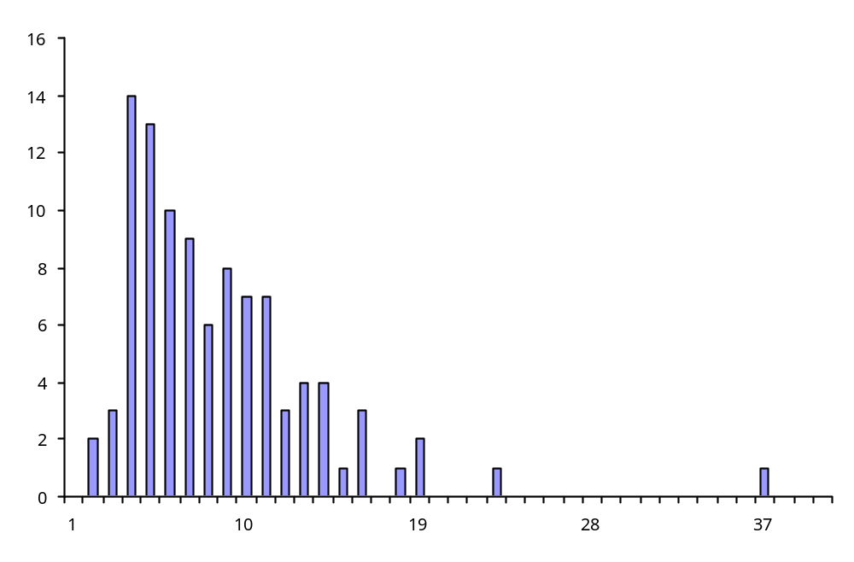
A randomization test shows that RBP
is significantly related to β-lactoglobulin
100 random shuffles
Mean score = 8.4
Std. dev. = 4.5
Number of instances
Real comparison
Score = 37
Quality score
But this test assumes a normal distribution of scores!
Page 77

Slide 44
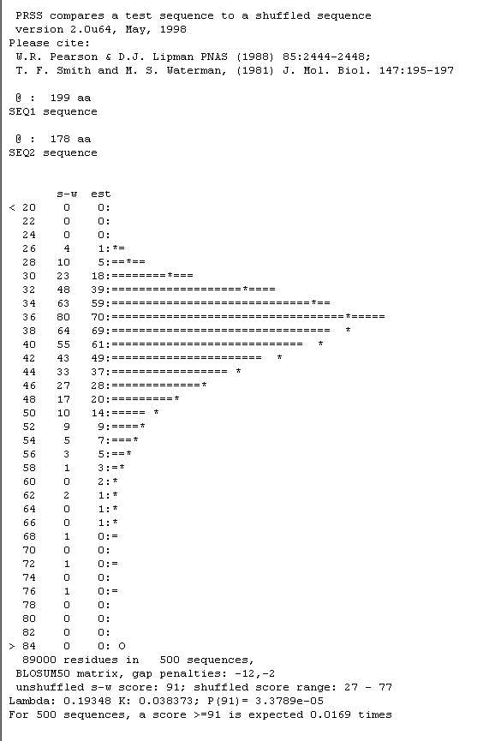
The PRSS program performs
a scramble test for you
(http://fasta.bioch.virginia.edu
/fasta/prss.htm)
Bad
scores
Good
scores
But these scores are not
normally distributed!

Slide 45
BLAST:
Basic local alignment
search tool
B
L
A
S
T
!

Slide 46
Pairwise alignment: key points
Pairwise alignments allow us to describe the percent identity
two sequences share, as well as the percent similarity
The score of a pairwise alignment includes positive values
for exact matches, and other scores for mismatches
and gaps
PAM and BLOSUM matrices provide a set of rules for
assigning scores. PAM10 and BLOSUM80 are examples of
matrices appropriate for the comparison of closely related
sequences. PAM250 and BLOSUM30 are examples of
matrices used to score distantly related proteins.
Global and local alignments can be made.

Slide 47
BLAST
BLAST (Basic Local Alignment Search Tool)
allows rapid sequence comparison of a query
sequence against a database.
The BLAST algorithm is fast, accurate,
and web-accessible.

Slide 48
Why use BLAST?
BLAST searching is fundamental to understanding
the relatedness of any favorite query sequence
to other known proteins or DNA sequences.
Applications include
identifying orthologs and paralogs
discovering new genes or proteins
discovering variants of genes or proteins
investigating expressed sequence tags (ESTs)
exploring protein structure and function

Slide 49
Four components to a BLAST search
(1) Choose the sequence (query)
(2) Select the BLAST program
(3) Choose the database to search
(4) Choose optional parameters
Then click “BLAST”

Slide 50
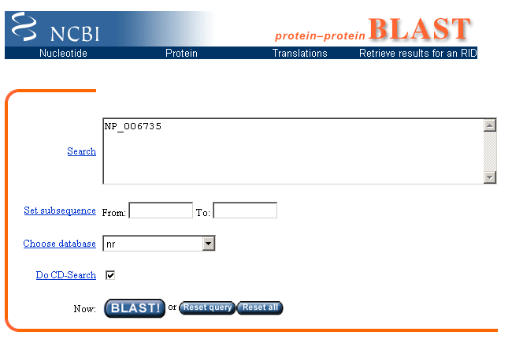

Slide 51
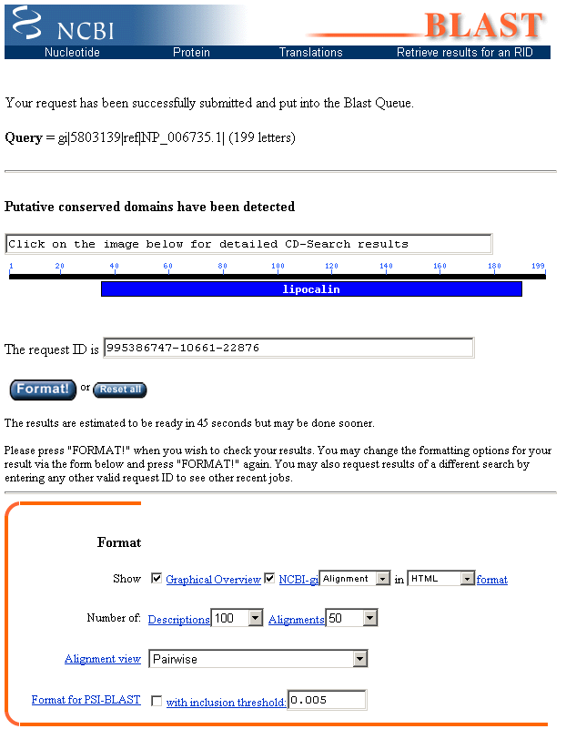

Slide 52
Step 1: Choose your sequence
Sequence can be input in FASTA format or as accession number

Slide 53
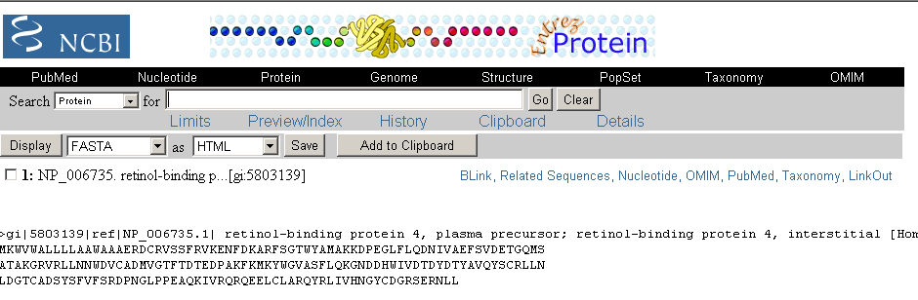
Example of the FASTA format for a BLAST query

Slide 54
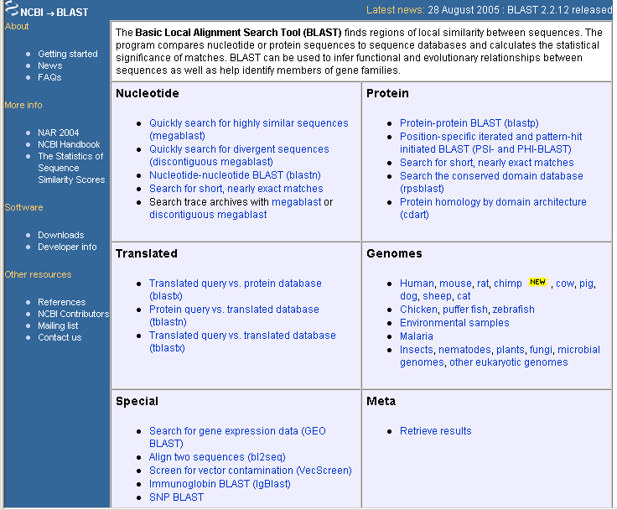
Step 2: Choose the BLAST program

Slide 55
Step 2: Choose the BLAST program
blastn (nucleotide BLAST)
blastp (protein BLAST)
tblastn (translated BLAST)
blastx (translated BLAST)
tblastx (translated BLAST)

Slide 56
Choose the BLAST program
Program Input Database
1
blastn DNA DNA
1
blastp protein protein
6
blastx DNA protein
6
tblastn protein DNA
36
tblastx DNA DNA

Slide 57
DNA potentially encodes six proteins
5’ CAT CAA
5’ ATC AAC
5’ TCA ACT
5’ CATCAACTACAACTCCAAAGACACCCTTACACATCAACAAACCTACCCAC 3’
3’ GTAGTTGATGTTGAGGTTTCTGTGGGAATGTGTAGTTGTTTGGATGGGTG 5’
5’ GTG GGT
5’ TGG GTA
5’ GGG TAG
page 92

Slide 58
Step 3: choose the database
nr = non-redundant (most general database)
dbest = database of expressed sequence tags
dbsts = database of sequence tag sites
gss = genomic survey sequences
htgs = high throughput genomic sequence
page 92-93

Slide 59
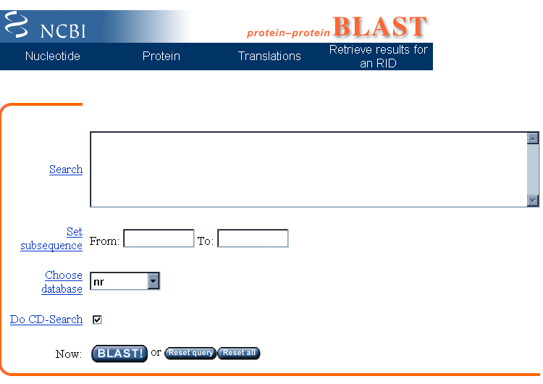
Step 4a: Select optional search parameters
CD search
page 93

Slide 60
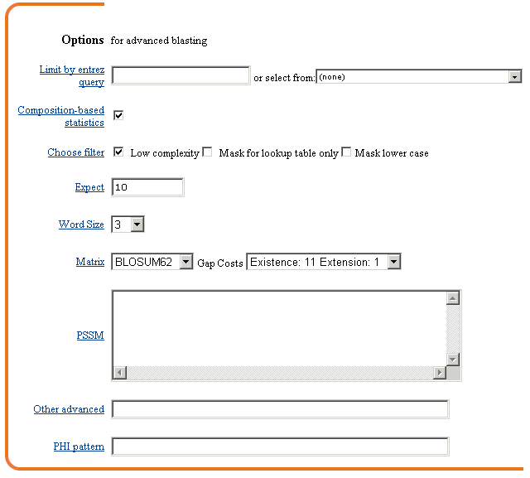
Step 4a: Select optional search parameters
Entrez!
Filter
Expect
Word size
organism
Scoring matrix
Fig. 4.5
page 94

Slide 61
BLAST: optional parameters
You can...
• choose the organism to search
• turn filtering on/off
• change the substitution matrix
• change the expect (e) value
• change the word size
• change the output format
page 93

Slide 62
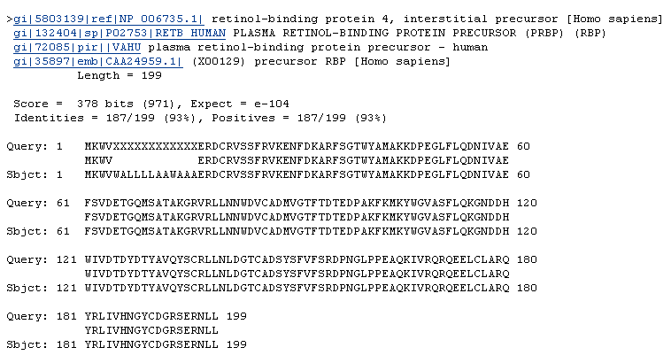
filtering
Fig. 4.6
page 95

Slide 63
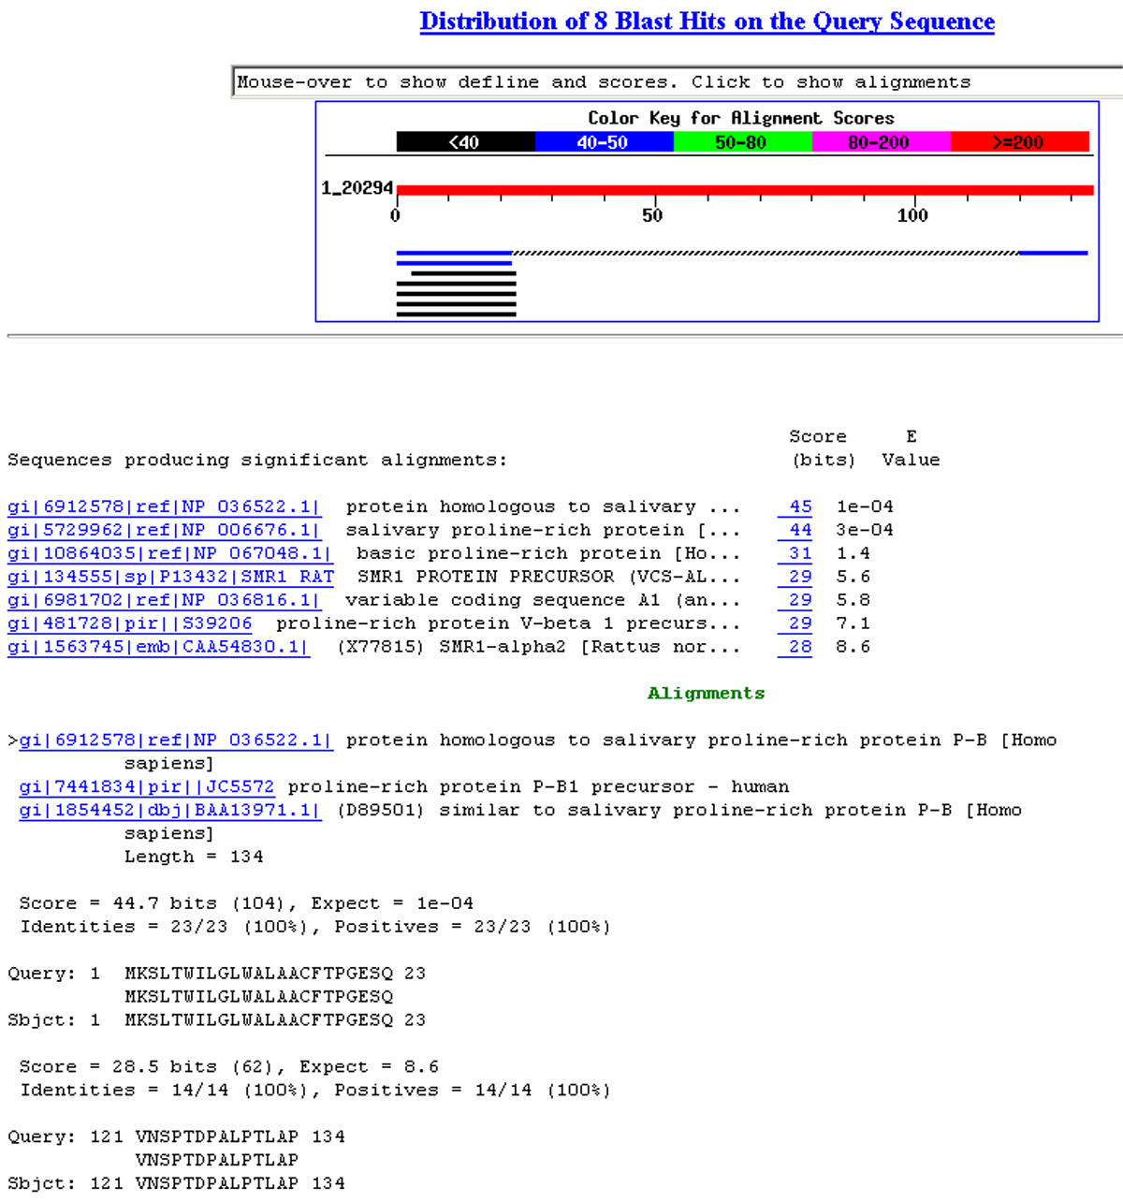
Fig. 4.7
page 95

Slide 64
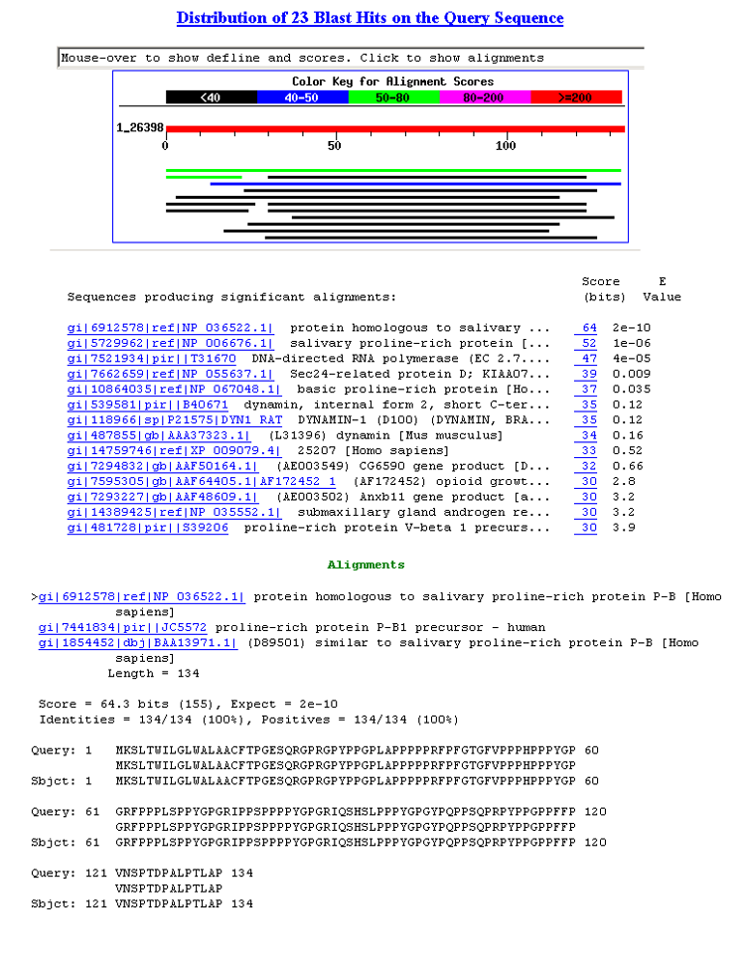
Fig. 4.8
page 96

Slide 65
Step 4b: optional formatting parameters
Alignment view
Descriptions
Alignments
page 97

Slide 66
(page 90)

Slide 67
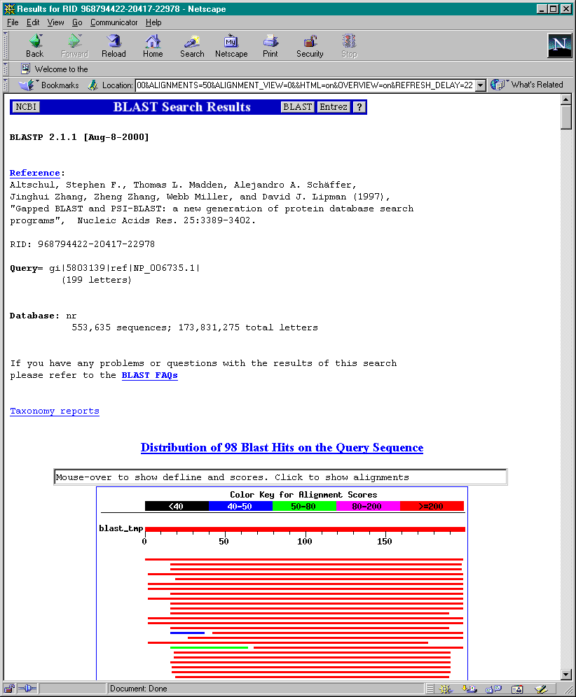
program
query
database
taxonomy
Fig. 4.9
page 98

Slide 68
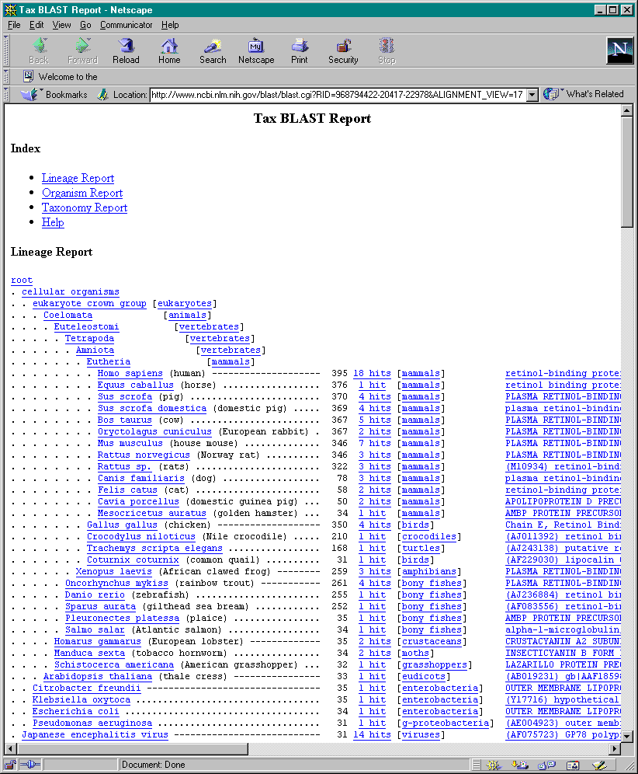
taxonomy
page 97

